Slide 1
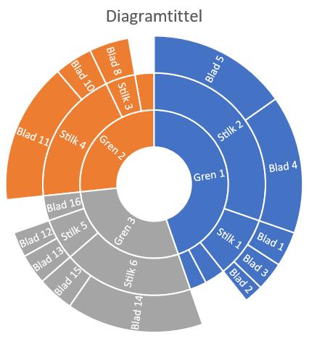
Communicating Statistics

Slide 2
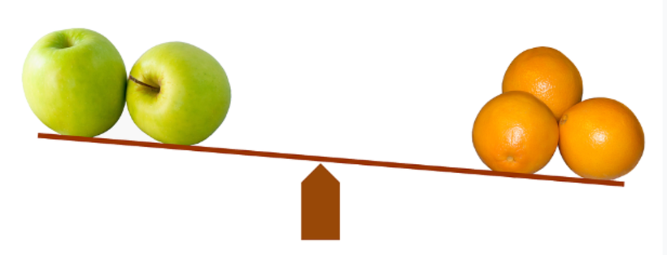
Compararing one thing to another
Comparative Adjectives:
This car is certainly better, but it's much more expensive. I'm feeling happier now. We need a bigger garden.
Use of THAN:
She is two years older than me. New York is much bigger than Boston. He is a better player than Ronaldo. France is a bigger country than Britain.

Slide 3

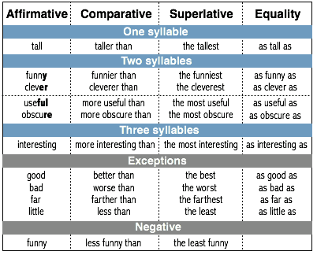

Slide 4
Using ‘the’ to compare
We often use the with comparative adjectives to show that one thing depends on another:
The faster you drive, the more dangerous it is. (= When you drive faster, it is more dangerous.)
The higher they climbed, the colder it became. (= When they climbed higher, it became colder.)

Slide 5

Task 1 Compare your holidays
Write a sentence for each section comparing two holidays using:
A comparative adjective (better, cheaper, etc)
‘Than’ (warmer than..)
A superlative (most expensive)
Equality (as warm as)
A negative (worse than etc)
‘The’ (The further north we drove, the colder it became)

Slide 6
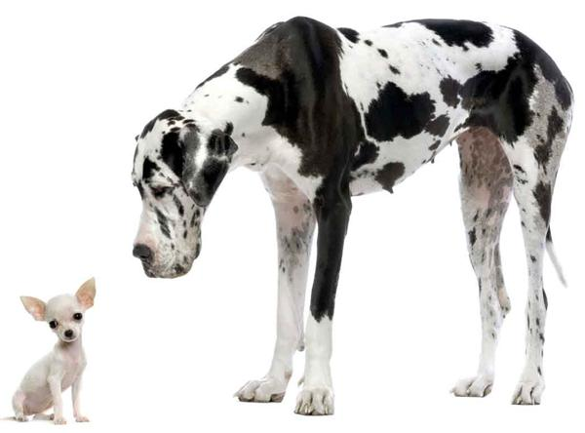
Intensifiers – these are often useful when giving your opinion on statistics
Huge (there is a huge difference between …. and ……….)
Phenomenal
Significant
Vast
Enormous
Substantial
Noteworthy
Major
Minor
Insignificant
Irrelevant
Slight
Negligible
Unrelated
Inconsequential
Lesser

Slide 7
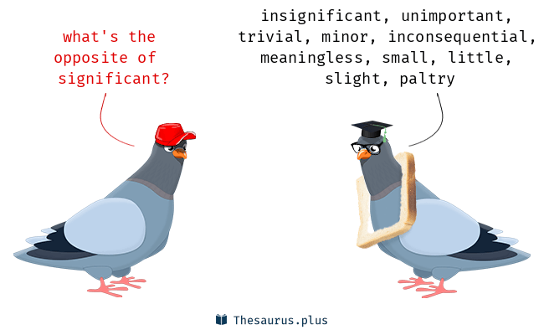
Mitigators and Intensifiers
Slightly
Marginally
Rather
Fairly
To some extent
Relatively
Moderately
Reasonably
Considerably
Significantly
To a great extent
Extremely
Noticeably
Markedly
Unusually
Example:
I think that it is significant that the number of coloured prisoners in US jails is considerably higher than non-coloured inmates.

Slide 8

Extra Information
Emphasise a big number by describing it as a four-figure/five-figure or six-figure number: (I’m not sure what he earns, but it’s certainly a six-figure number)
We can say a number is in the tens/the hundreds/the thousands/the millions. For very big numbers a number can be (in the) tens of thousands, hundreds of thousands, tens of millions etc: (They’ve cut hundreds of thousands of pounds from the budget.)
Their assets alone must be worth in the tens of millions.
We can say a number is in triple figures (100-999):
(The number of emails waiting for me after my holiday was in triple figures.)

Slide 9
Links to exercises
https://ngl.cengage.com/assets/downloads/grex_pro0000000538/grex2_su8.pdf
https://test-english.com/grammar-points/b1/comparative-superlative-adjectives-adverbs/
https://englishpost.org/teaching-grammar-intensifiers/

